Slide 1
CS 106A, Lecture 4 Introduction to Java
suggested reading:
Karel, Ch. 5-6

Slide 2
Plan For Today
Announcements
Bye, Karel!
Console Programs
Variables
Expressions
Practice: Receipt

Slide 3
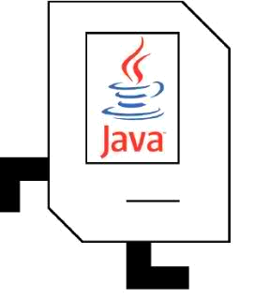
Plan For Today
Announcements
Bye, Karel!
Console Programs
Variables
Expressions
Practice: Receipt

Slide 4


Bye, Karel!
I will miss you.
Enjoy Java!
See you on the midterm .

Slide 5
Plan For Today
Announcements
Bye, Karel!
Console Programs
Variables
Expressions
Practice: Receipt

Slide 6
Java
Program
Karel Program
Console Program
Graphics Program
SuperKarel Program

Slide 7
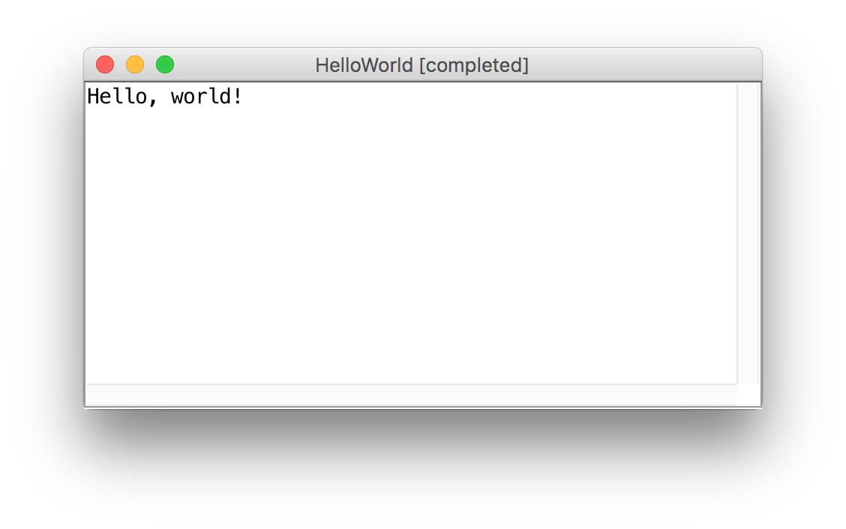
Our First Java Program

Slide 8
Our First Java Program
import acm.program.*;
public class HelloWorld extends ConsoleProgram {
public void run() { println(“Hello, world!”);
}
}

Slide 9
Console Programs
import acm.program.*;
public class Name extends ConsoleProgram {
public void run() {
statements;
}
}
Unlike Karel, many programs produce their behavior as text.
console: Text box into which the behavior is displayed.
output: Messages displayed by the program.
input: Data read by the program that the user types.

Slide 10
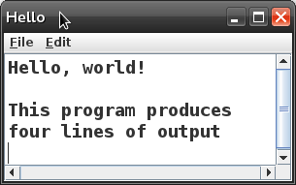
Console Programs
public class Hello extends ConsoleProgram {
public void run() {
println("Hello, world!");
println();
println("This program produces");
println("four lines of output");
}
}

Slide 11
println
A statement that prints a line of output on the console, and goes to the next line.
pronounced "print-linn"
Two ways to use println :
println("text");
Prints the given message as output, and goes to the next line.
A message is called a string; it starts/ends with a " quote character.
The quotes do not appear in the output.
A string may not contain a " character.
println();
Prints a blank line of output.

Slide 12
print
public class HelloWorld extends ConsoleProgram {
public void run() {
print("Hello, ");
print("world!");
}
}
Same as println, but does not go to the next line.

Slide 13
Escape sequences
escape sequence: A special sequence of characters used to represent certain special characters in a string.
\t tab character
\n new line character
\" quotation mark character
\\ backslash character
Example: println("\\hello\nhow\tare \"you\"?\\\\");
Output: \hello how are "you"?\\

Slide 14

Add2Integers
class Add2Integers extends ConsoleProgram {
public void run() {
println("This program adds two numbers.");
int n1 = readInt("Enter n1: ");
int n2 = readInt("Enter n2: ");
int total = n1 + n2;
println("The total is " + total + ".");
}
}
n1
n1
n2
n2
total
total
Add2Integers

Slide 15
Add2Integers
class Add2Integers extends ConsoleProgram {
public void run() {
println("This program adds two numbers.");
int n1 = readInt("Enter n1: ");
int n2 = readInt("Enter n2: ");
int total = n1 + n2;
println("The total is " + total + ".");
}
}
n1
n1
n2
n2
total
total
Add2Integers

Slide 16
Add2Integers
class Add2Integers extends ConsoleProgram {
public void run() {
println("This program adds two numbers.");
int n1 = readInt("Enter n1: ");
int n2 = readInt("Enter n2: ");
int total = n1 + n2;
println("The total is " + total + ".");
}
}
n1
n1
n2
n2
total
total
Add2Integers
This program adds two numbers.

Slide 17
Add2Integers
class Add2Integers extends ConsoleProgram {
public void run() {
println("This program adds two numbers.");
int n1 = readInt("Enter n1: ");
int n2 = readInt("Enter n2: ");
int total = n1 + n2;
println("The total is " + total + ".");
}
}
n1
n1
n2
n2
total
total
Add2Integers
This program adds two numbers.

Slide 18
Add2Integers
class Add2Integers extends ConsoleProgram {
public void run() {
println("This program adds two numbers.");
int n1 = readInt("Enter n1: ");
int n2 = readInt("Enter n2: ");
int total = n1 + n2;
println("The total is " + total + ".");
}
}
n1
n1
n2
n2
total
total
Add2Integers
This program adds two numbers.
Enter n1:

Slide 19
Add2Integers
class Add2Integers extends ConsoleProgram {
public void run() {
println("This program adds two numbers.");
int n1 = readInt("Enter n1: ");
int n2 = readInt("Enter n2: ");
int total = n1 + n2;
println("The total is " + total + ".");
}
}
n1
n1
n2
n2
total
total
Add2Integers
This program adds two numbers.
17
Enter n1:

Slide 20
Add2Integers
class Add2Integers extends ConsoleProgram {
public void run() {
println("This program adds two numbers.");
int n1 = readInt("Enter n1: ");
int n2 = readInt("Enter n2: ");
int total = n1 + n2;
println("The total is " + total + ".");
}
}
n1
n1
n2
n2
total
total
17
Add2Integers
This program adds two numbers.
17
Enter n1:

Slide 21
Add2Integers
class Add2Integers extends ConsoleProgram {
public void run() {
println("This program adds two numbers.");
int n1 = readInt("Enter n1: ");
int n2 = readInt("Enter n2: ");
int total = n1 + n2;
println("The total is " + total + ".");
}
}
n1
n1
n2
n2
total
total
17
Add2Integers
This program adds two numbers.
17
Enter n1:

Slide 22
Add2Integers
class Add2Integers extends ConsoleProgram {
public void run() {
println("This program adds two numbers.");
int n1 = readInt("Enter n1: ");
int n2 = readInt("Enter n2: ");
int total = n1 + n2;
println("The total is " + total + ".");
}
}
n1
n1
n2
n2
total
total
17
Add2Integers
This program adds two numbers.
17
Enter n1:
Enter n2:

Slide 23
Add2Integers
class Add2Integers extends ConsoleProgram {
public void run() {
println("This program adds two numbers.");
int n1 = readInt("Enter n1: ");
int n2 = readInt("Enter n2: ");
int total = n1 + n2;
println("The total is " + total + ".");
}
}
n1
n1
n2
n2
total
total
17
Add2Integers
This program adds two numbers.
17
Enter n1:
Enter n2:
25

Slide 24
Add2Integers
class Add2Integers extends ConsoleProgram {
public void run() {
println("This program adds two numbers.");
int n1 = readInt("Enter n1: ");
int n2 = readInt("Enter n2: ");
int total = n1 + n2;
println("The total is " + total + ".");
}
}
n1
n1
n2
n2
total
total
17
25
Add2Integers
This program adds two numbers.
17
Enter n1:
Enter n2:
25

Slide 25
Add2Integers
class Add2Integers extends ConsoleProgram {
public void run() {
println("This program adds two numbers.");
int n1 = readInt("Enter n1: ");
int n2 = readInt("Enter n2: ");
int total = n1 + n2;
println("The total is " + total + ".");
}
}
n1
n1
n2
n2
total
total
17
25
Add2Integers
This program adds two numbers.
17
Enter n1:
Enter n2:
25

Slide 26
Add2Integers
class Add2Integers extends ConsoleProgram {
public void run() {
println("This program adds two numbers.");
int n1 = readInt("Enter n1: ");
int n2 = readInt("Enter n2: ");
int total = n1 + n2;
println("The total is " + total + ".");
}
}
n1
n1
n2
n2
total
total
17
25
42
Add2Integers
This program adds two numbers.
17
Enter n1:
Enter n2:
25

Slide 27
Add2Integers
class Add2Integers extends ConsoleProgram {
public void run() {
println("This program adds two numbers.");
int n1 = readInt("Enter n1: ");
int n2 = readInt("Enter n2: ");
int total = n1 + n2;
println("The total is " + total + ".");
}
}
n1
n1
n2
n2
total
total
17
25
42
Add2Integers
This program adds two numbers.
17
Enter n1:
Enter n2:
25

Slide 28
Add2Integers
class Add2Integers extends ConsoleProgram {
public void run() {
println("This program adds two numbers.");
int n1 = readInt("Enter n1: ");
int n2 = readInt("Enter n2: ");
int total = n1 + n2;
println("The total is " + total + ".");
}
}
n1
n1
n2
n2
total
total
17
25
42
Add2Integers
This program adds two numbers.
17
Enter n1:
Enter n2:
25
The total is 42.

Slide 29
Add2Integers
class Add2Integers extends ConsoleProgram {
public void run() {
println("This program adds two numbers.");
int n1 = readInt("Enter n1: ");
int n2 = readInt("Enter n2: ");
int total = n1 + n2;
println("The total is " + total + ".");
}
}
n1
n1
n2
n2
total
total
17
25
42
Add2Integers
This program adds two numbers.
17
Enter n1:
Enter n2:
25
The total is 42.

Slide 30
Plan For Today
Announcements
Bye, Karel!
Console Programs
Variables
Expressions
Practice: Receipt

Slide 31
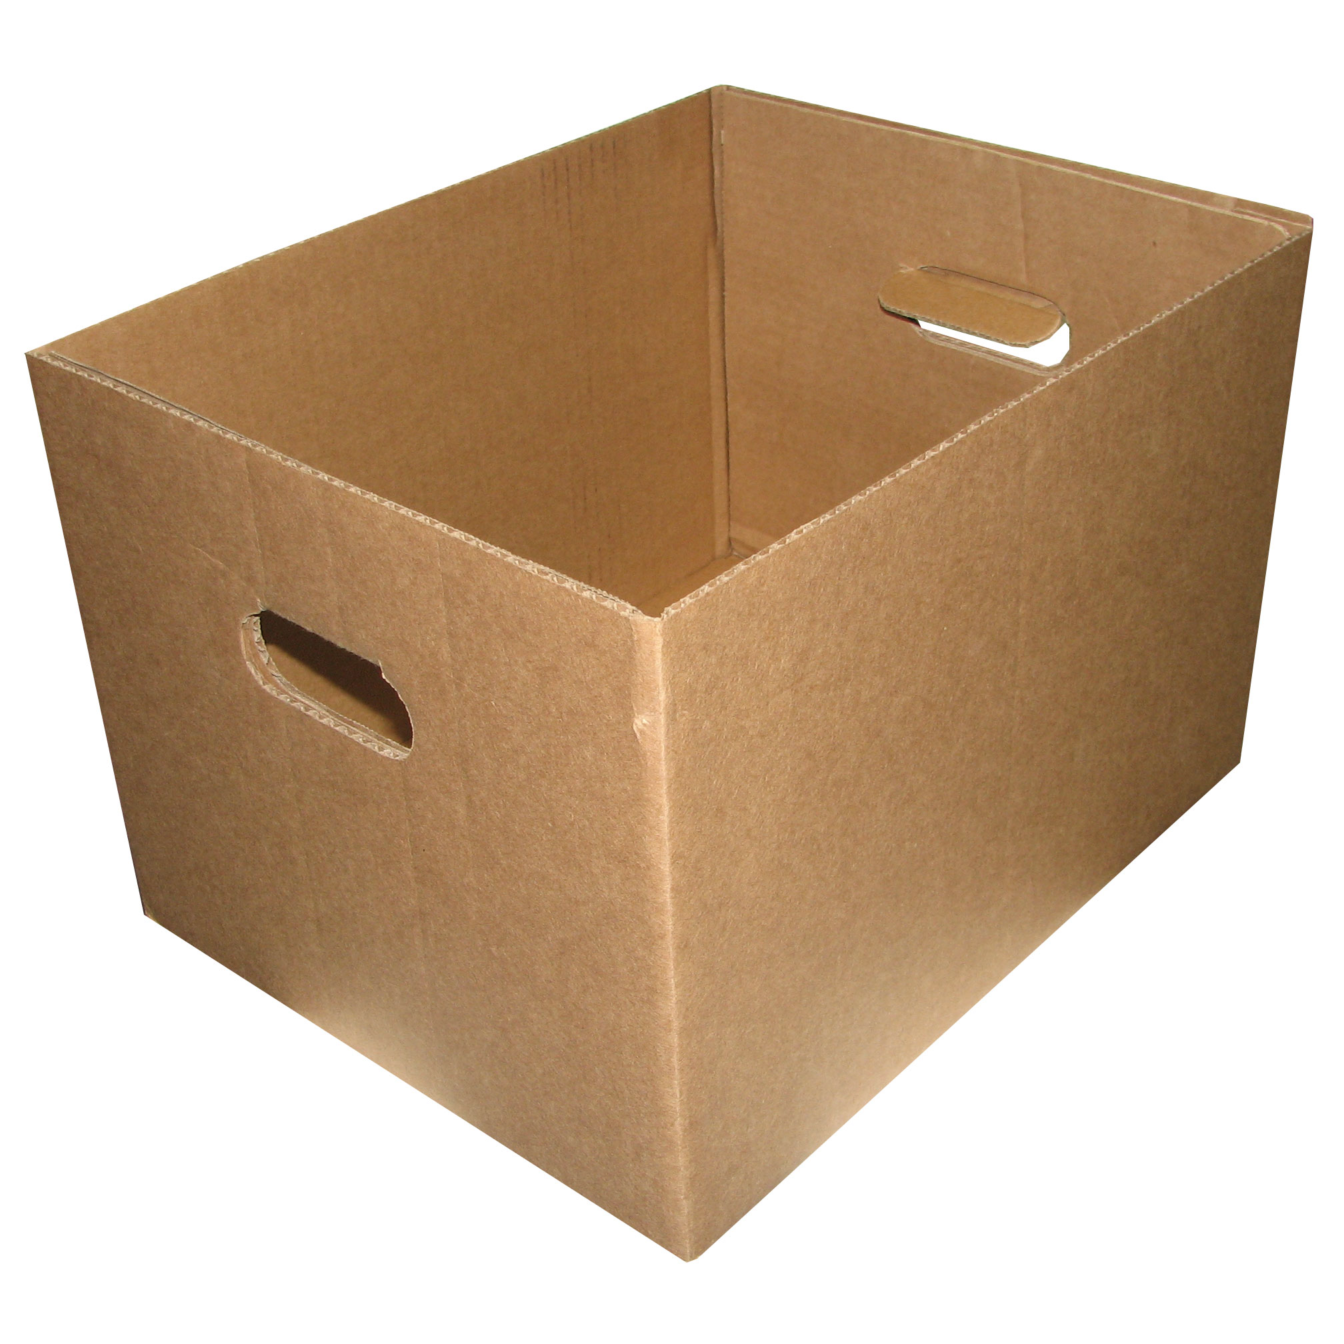
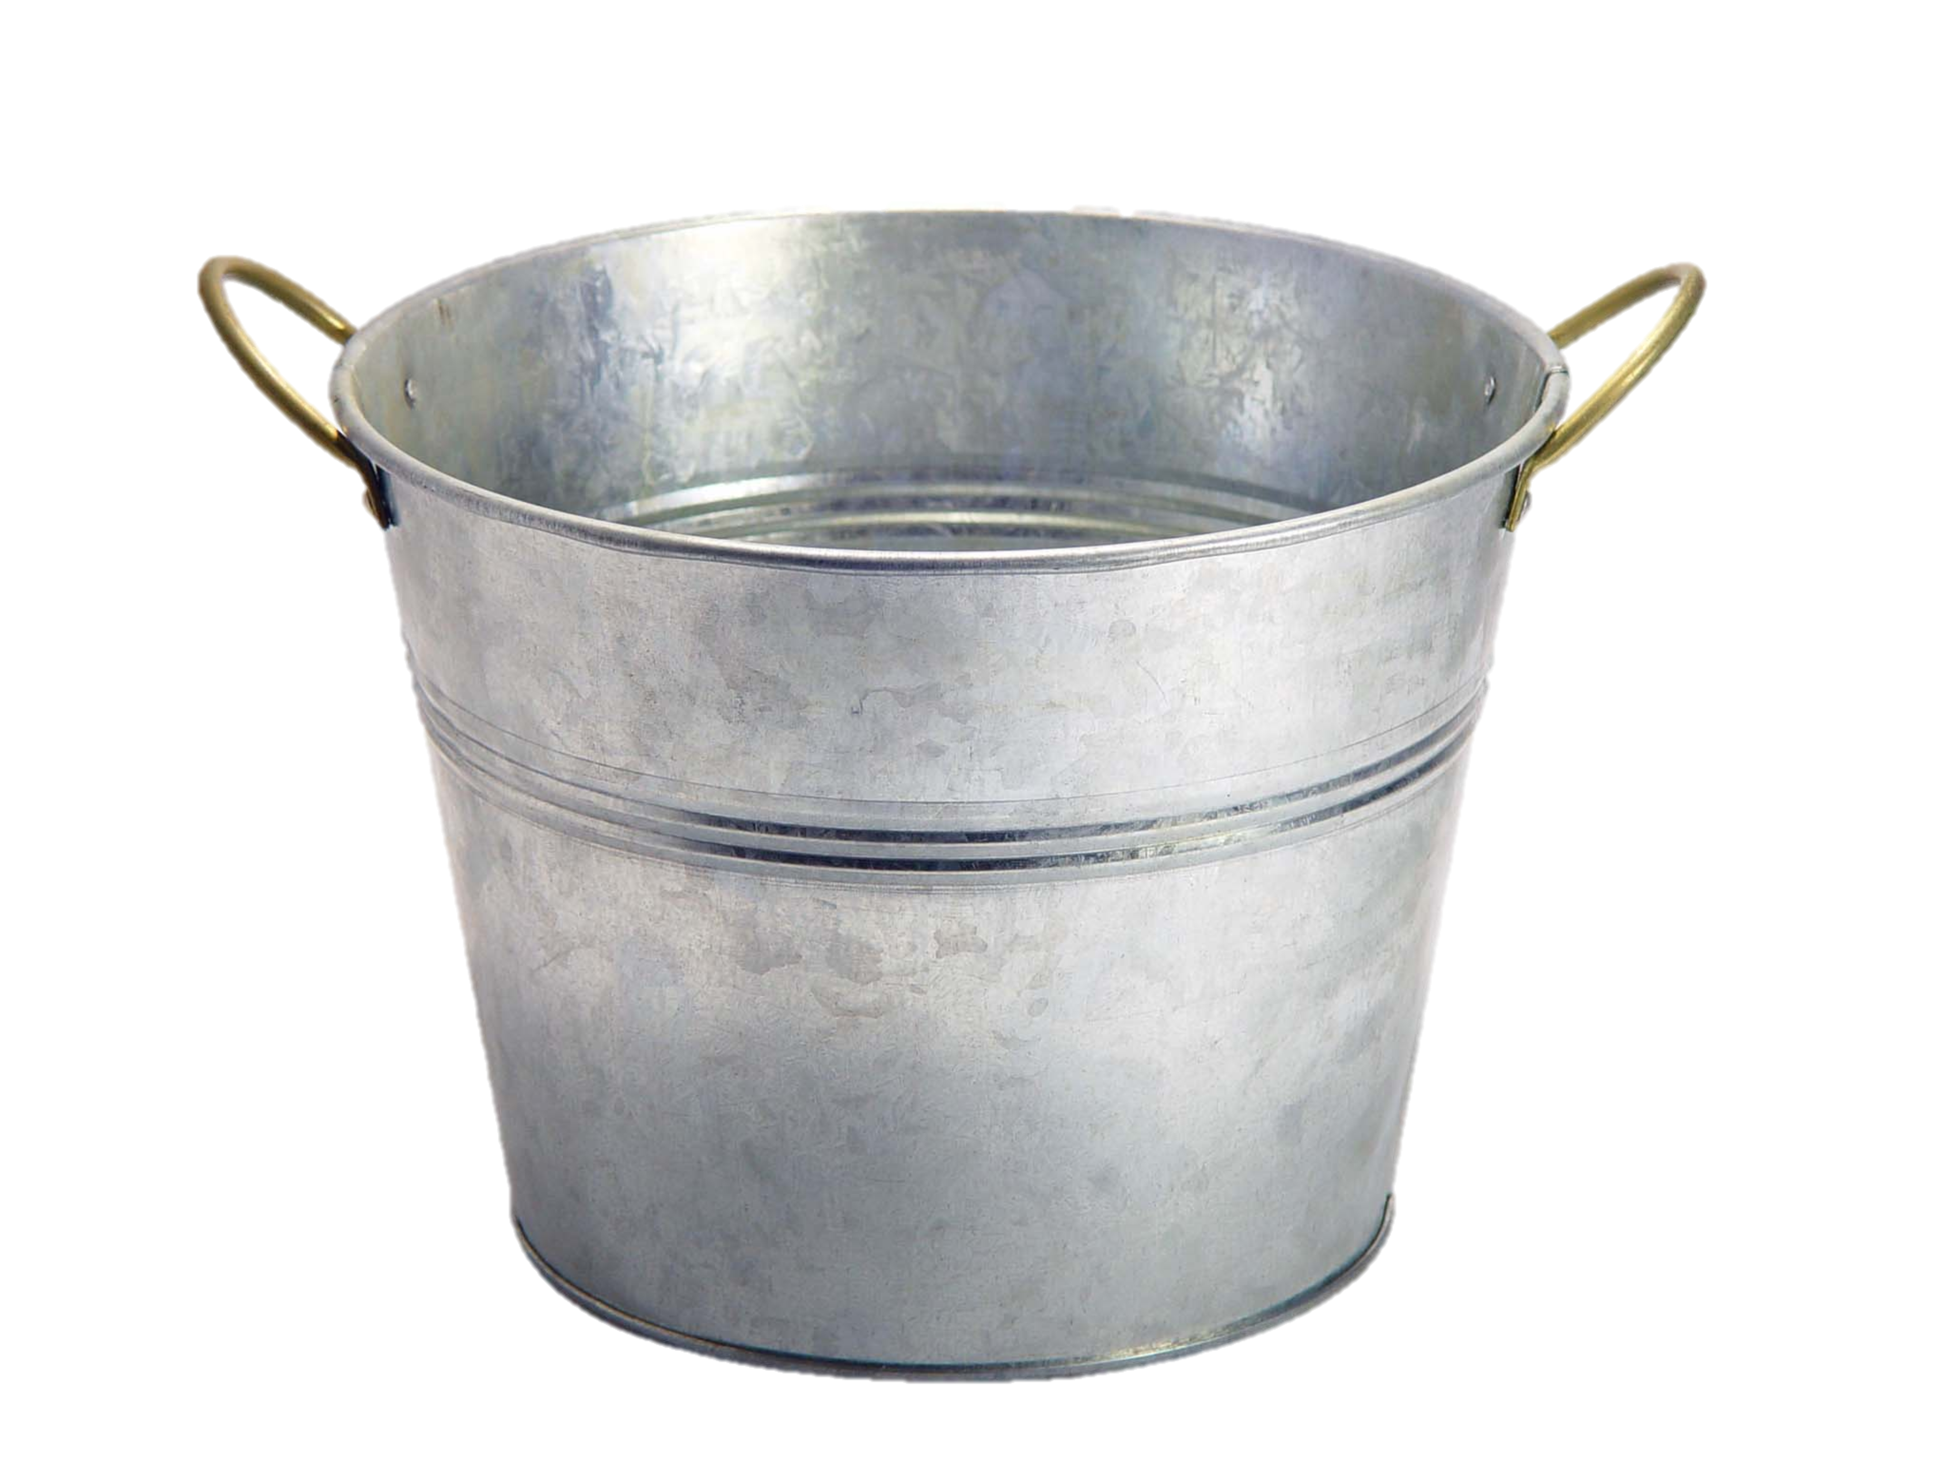
Variables = Boxes

Slide 32
Variables = Boxes
My computer has space for about 2 billion boxes

Slide 33
Making a new Variable
int myVariable;

Slide 34
Making a new Variable
type
name
int myVariable;

Slide 35
Variable Types
int – an integer number
double – a decimal number
char – a single character
boolean – true or false

Slide 36
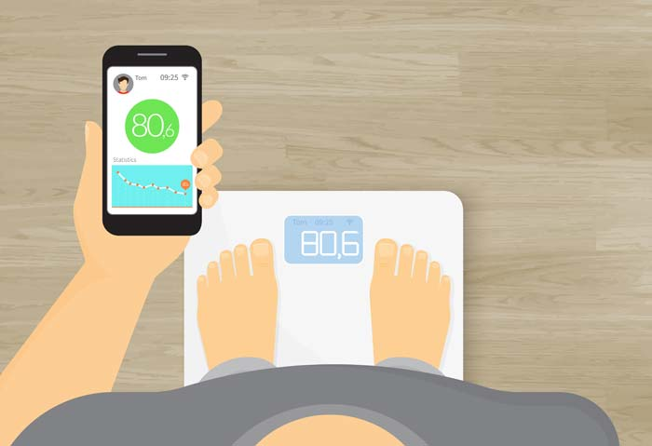
How much do I weigh?
double – answer is real number

Slide 37
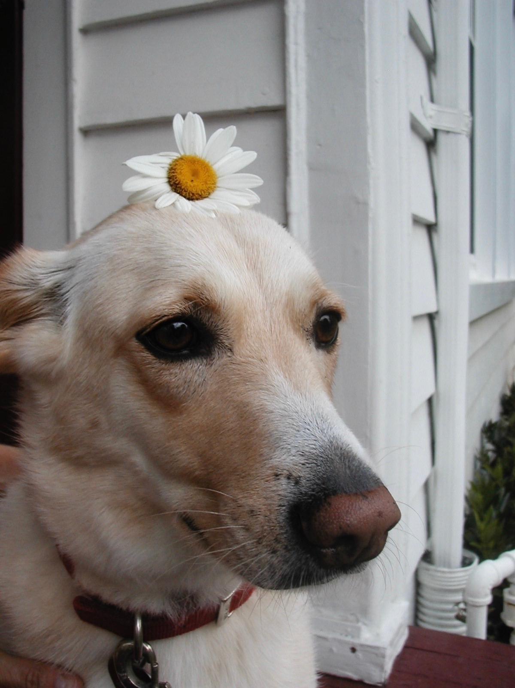
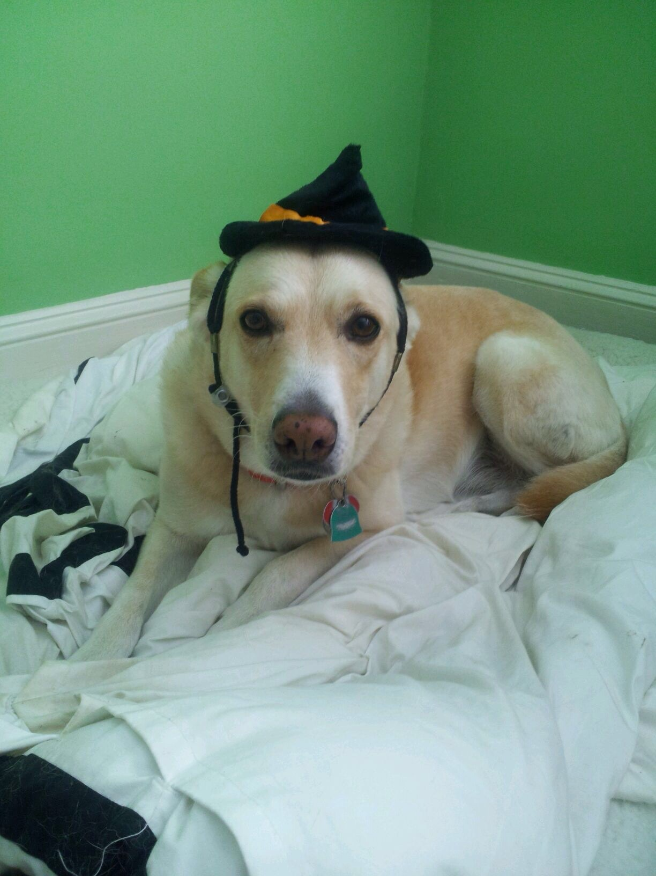
How many pets do I have?
int – answer is an integer
Notes:
How much vs how many

Slide 38
double vs. int
How much vs. how many
Notes:
Behavior is slightly different too, we’ll get to that later

Slide 39
Declaration
variable declaration: Sets aside memory for storing a value.
Variables must be declared before they can be used.
Syntax:
type name;
int zipcode;
double myGPA;
zipcode
myGPA

Slide 40
Assignment
value
Existing variable name
myVariable = 2;

Slide 41
Assignment
// integer values
int num;
num = 5;
// real values
double fraction;
fraction = 0.2;
// a single letter
char letter;
letter = ‘c’;
// true or false
boolean isLove;
isLove = true;

Slide 42
Assignment
assignment: Stores a value into a variable.
The value can be an expression; the variable stores its result.
Syntax:
name = expression;
int zipcode;
zipcode = 90210;
double myGPA;
myGPA = 1.0 + 2.25;
zipcode | 90210
myGPA | 3.25

Slide 43
Declare / initialize
A variable can be declared/initialized in one statement.
This is probably the most commonly used declaration syntax.
Syntax:
type name = expression;
double tempF = 98.6;
int x = (11 / 2) + 3;
tempF | 98.6
x | 8

Slide 44
‘=‘ Means Assignment
Assignment uses = , but it is not an algebraic equation.
= means, "store the value at right in the variable at left"
The right side expression is evaluated first, and then its result is stored in the variable at left.
What happens here?
int x = 3;
x = x + 2; // ???
x | 3
x | 5

Slide 45
Assignment and types
A variable can only store a value of its own type.
int x = 2.5; // Error: incompatible types
An int value can be stored in a double variable.
The value is converted into the equivalent real number.
double myGPA = 4;
myGPA | 4.0

Slide 46
Compiler Errors
A variable can't be used until it is assigned a value.
int x;
println(x); // Error: x has no value
You may not declare the same variable twice.
int x;
int x; // ERROR: x already exists
int y = 3;
int y = 5; // Error: y already exists
Notes:
How can we fix this?

Slide 47
Using Variables
// Asks the user for an integer by
// displaying the given message
// and stores it in the variable ’a’
int a = readInt(message);
// Asks the user for a double by
// displaying the given message and
// stores it in the variable ’b’
double b = readDouble(message);
Notes:
This will wait for the user to input a number and then continue executing your program

Slide 48
Using Variables
Use + to print a string and a variable's value on one line.
double grade = (95.1 + 71.9 + 82.6) / 3.0;
println("Your grade was " + grade);
int enrolled = 11 + 17 + 4 + 19 + 14;
println("There are " + enrolled + " students.");
Output:
Your grade was 83.2
There are 65 students.

Slide 49
Using Variables
Once given a value, a variable can be used in expressions:
int x = 3;
println("x is " + x); // x is 3
println(5 * x - 1); // 5 * 3 - 1
You can assign a value more than once:
int x = 3; println(x + " here"); // 3 here x = 4 + 7; println("now x is " + x); // now x is 11
x | 3
x | 11
Notes:
Useful – save the same value and reuse it or change it

Slide 50
Plan For Today
Announcements
Bye, Karel!
Console Programs
Variables
Expressions
Practice: Receipt

Slide 51
Expressions
You can combine literals or variables together into expressions using binary operators:
+
Addition
*
Multiplication
–
Subtraction
Division
/
%
Remainder

Slide 52
Precedence
precedence: Order in which operators are evaluated.
Generally operators evaluate left-to-right. 1 - 2 - 3 is (1 - 2) - 3 which is -4
But * / % have a higher level of precedence than + - 1 + 3 * 4 is 13
6 + 8 / 2 * 3
6 + 4 * 3
6 + 12 is 18
Parentheses can alter order of evaluation, but spacing does not: (1 + 3) * 4 is 16 1+3 * 4-2 is 11
Notes:
One operator you might not have seen before is…. (%)

Slide 53
Integer remainder %
The % operator computes the remainder from integer division.
14 % 4 is 2
218 % 5 is 3 3 43 4 ) 14 5 ) 218 12 20 2 18 15 3
Applications of % operator:
Obtain last digit of a number: 230857 % 10 is 7
Obtain last 4 digits: 658236489 % 10000 is 6489
See whether a number is odd: 7 % 2 is 1, but 42 % 2 is 0
Notes:
Only for integers
Now + is more versatile than you might expect…

Slide 54

String concatenation
expressionsStrings1
string concatenation: Using + between a string and another value to make a longer string.
"hello" + 42 is "hello42"
1 + "abc" + 2 is "1abc2"
"abc" + 1 + 2 is "abc12"
1 + 2 + "abc" is "3abc"
"abc" + 9 * 3 is "abc27"
"1" + 1 is "11"
4 - 1 + "abc" is "3abc"
Use + to print a string and an expression's value together.
println("Average: " + (95.1 + 71.9) / 2);
Output: Average: 83.5
Notes:
There is some other weird behavior with operators…

Slide 55
What does this do?
println(1 / 2);

Slide 56
What does this do?
println(1 / 2);
0!

Slide 57
Integer division
When we divide integers, the quotient is also an integer.
14 / 4 is 3, not 3.5 . (Java ALWAYS rounds down.)
3 4 52
4 ) 14 10 ) 45 27 ) 1425
12 40 135
2 5 75
54
21
More examples:
32 / 5 is 6
84 / 10 is 8
156 / 100 is 1
Dividing by 0 causes an error when your program runs.

Slide 58
Type Interactions
int and int results in an int
double and double results in a double
int and double results in a double
* The general rule is: operations always return the most expressive type
Notes:
MOST EXPRESSIVE TYPE –you can make an int into a string but not all strings into an int

Slide 59
Type Interactions
Convert 100˚ Celsius temperature to its Fahrenheit equivalent:
double c = 100;
double f = 9 / 5 * c + 32;
The computation consists of evaluating the following expression:
9 / 5 * c + 32
The problem arises from the fact that both 9 and 5 are of type int, which means that the result is also an int.
132
100
1
9 / 5 * c + 32
Notes:
2 terms at a time
How can we fix this?

Slide 60
Pitfalls of Integer Division
You can fix this problem by converting the fraction to a double:
double c = 100;
double f = 9.0 / 5 * c + 32;
The computation now looks like this:
212.0
180.0
1.8
9.0
/ 5 * c + 32
Notes:
2 terms at a time

Slide 61
Practice
5 + 3 / 2 - 4
15 / 2.0 + 6
1 * 2 + 3 * 5 % 4
“abc” + 1 + 2
“abc” + (1 + 2)
Notes:
2
13.5
11
abc12
abc3

Slide 62
Precedence examples
1 * 2 + 3 * 5 % 4
\_/ | 2 + 3 * 5 % 4
\_/ | 2 + 15 % 4
\___/ | 2 + 3
\________/ | 5
“abc” + 1 + 2
\_/ | “abc1” + 2
\___/ | “abc12”

Slide 63
Plan For Today
Announcements
Bye, Karel!
Console Programs
Variables
Expressions
Practice: Receipt

Slide 64
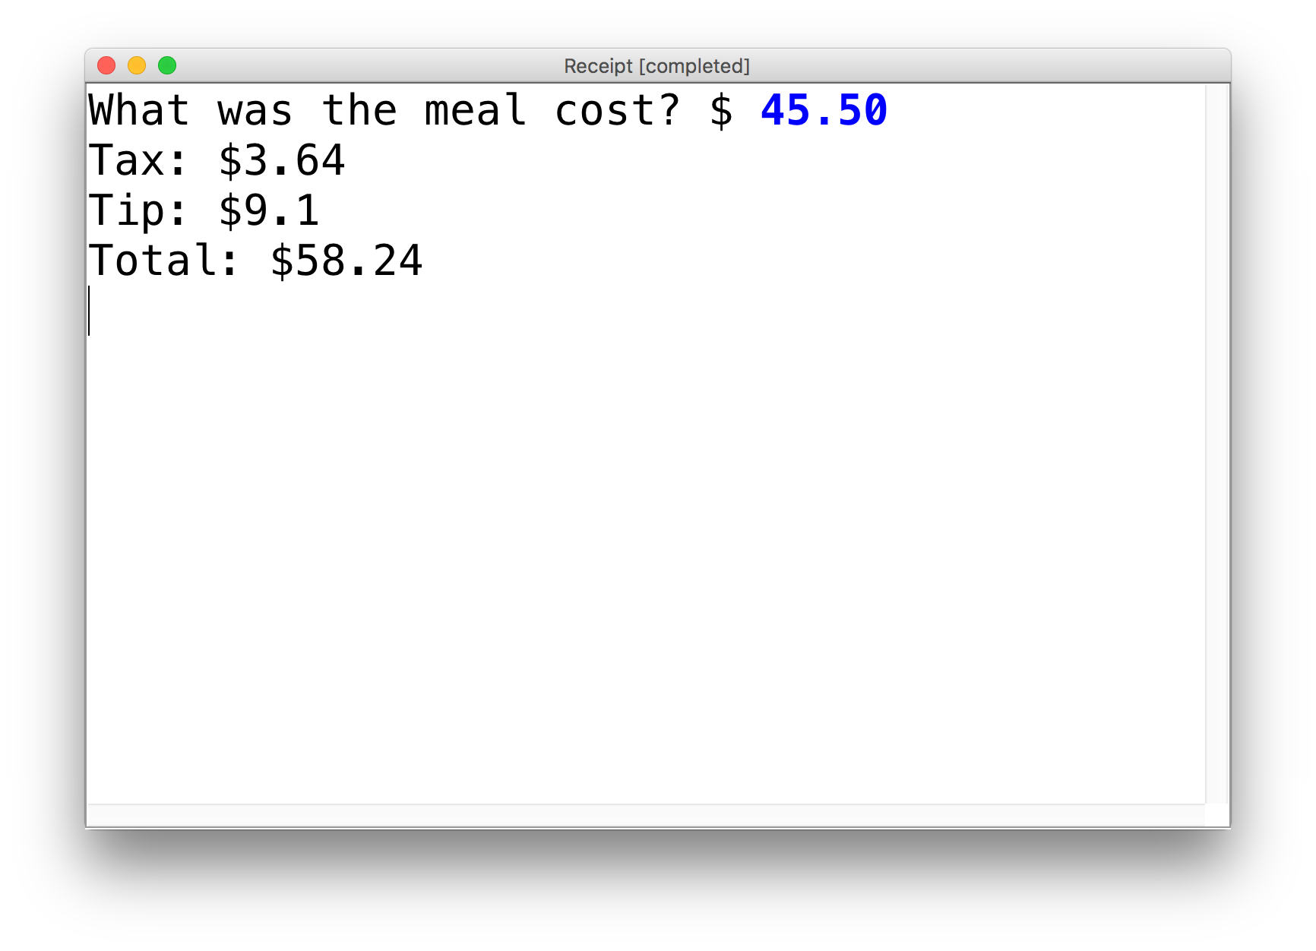
Practice: Receipt Program
Let’s write a ConsoleProgram that calculates the tax, tip and total bill for us at a restaurant.
The program should ask the user for the subtotal, and then calculate and print out the tax, tip and total.

Slide 65
Practice: Receipt Program
public class Receipt extends ConsoleProgram {
public void run() {
double subtotal = readDouble(”Meal cost? $”);
double tax = subtotal * 0.08;
double tip = subtotal * 0.20;
double total = subtotal + tax + tip;
println("Tax : $” + tax);
println("Tip: $” + tip);
println(”Total: $" + total);
}
}

Slide 66
Recap
Announcements
Bye, Karel!
Console Programs
Variables
Expressions
Practice: Receipt
Next time: Control flow in Java

